Slide 1
Setting Up LHR Data Sync With OCLC: Not Just for Serials!
ELUNA 2024
Martin Patrick: martin.patrick@library.gatech.edu
Deets on the git: https://github.com/martinpatrick/eluna2024

Slide 2
Goals

Slide 3
For Today
What are the benefits of LHR based DataSync?
How to set up LHR DataSync.
How to use the holdings normalize on save rule in Alma to automatically apply custom normalization rules to holdings record on every save.

Slide 4
What is DataSync?
Synchronizes catalog based on OCLC number in the record with OCLC’s services.
Alma includes out-of-the-box profiles for bib-based and/or LHR-based sync that can run on a schedule.
These also automatically detect when they need to publish an update to OCLC.
It’s also possible to set up a Publishing Profile to OCLC if you have specific customizations the built in profiles don’t address.

Slide 5
LHR DataSync
Syncs holdings with OCLC based on your holdings record.
Holdings ID -> Local System Number
OCLC# -> applied automatically by Alma during publishing from the bib record
Triggers:
New holdings record
Deleted holdings record
Changes to an existing record

Slide 6
GT’s Goals for DataSync
Use the DataSync process to keep our holdings in sync between Alma and OCLC.
Indicate to OCLC and thus, other libraries, what we will/won’t lend/reproduce at the item level to improve ILL borrowing request processes.
Make it as automatic as possible, relying on Alma’s built-in tools as much as possible to reduce the number of places changes have to be made.

Slide 7
Georgia Tech’s Environment

Slide 8
Georgia Tech’s Environment
Most material stored in off-site storage called the Library Service Center
LSC set up as Alma library with multiple locations that are not format related
LSC/GENERAL, for example, contains books, journals, dvds, etc.
ILL practices are governed by material type and not location
Withdrawn location instead of withdrawn job.
This choice is not ‘the best’ it’s just the one we went with.
Notes:
We will not lend journals housed in LSC/GENERAL, but will lend books in LSC/GENERAL
Reproduce journals from LSC, but not from Main/CORE
We lend DVDs housed in LSC/GENERAL within Georgia

Slide 9
It was a long road

Slide 10
Timeline
2019 – Full reclamation
2019 – Holding cleanup project begins
2021 – Metadata Librarian leaves
Fall 2022 – I started at GT and they were still processing reclamation reports and still cleaning up holdings records
Summer 2023 – We took advantage of OCLC’s free Streamlined Holdings service and begin cleanup and prepwork
Lots of thinking, testing, validating, prototyping, etc.
Late Fall 2023 – Officially turned on DataSync
December 2023 – New Metadata Librarian starts (yay!)

Slide 11
Why Bib Sync Isn’t Ideal for GT

Slide 12
Bib Sync Concerns
Out of the box DataSync profile does not allow customization of what gets published.
Does changing holdings cause the DataSync profile to send updated bib data to OCLC?
Tedium of mapping every possible holdings field into the bib record into a bespoke profile, coupled with the workload of setting up a custom data feed to OCLC
Local cataloging practices have suffered from chaotic staff turnover.

Slide 13
Holdings Sync Pros
Alma already maintains local holdings records in MFHD for every bib record
Problems in bibliographic cataloging will not interfere with DataSync
Out of the box holdings DataSync publishes the LHR data as it is in Alma, and if we update in Alma, that gets transmitted to OCLC
Can use normalize on save routines to calculate the 008 bits for lending and reproduction policy
The OCLC# is pulled from the bib record at publishing.

Slide 14
Automating the Details

Slide 15
Setup and Automation
Alma cleanup steps
Holdings normalize on save
Handling withdawals

Slide 16
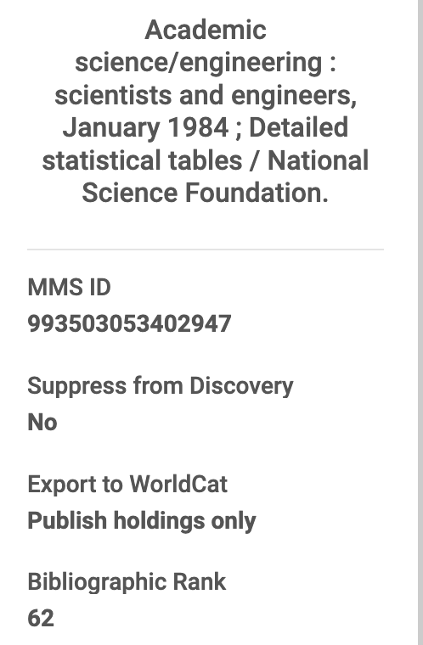
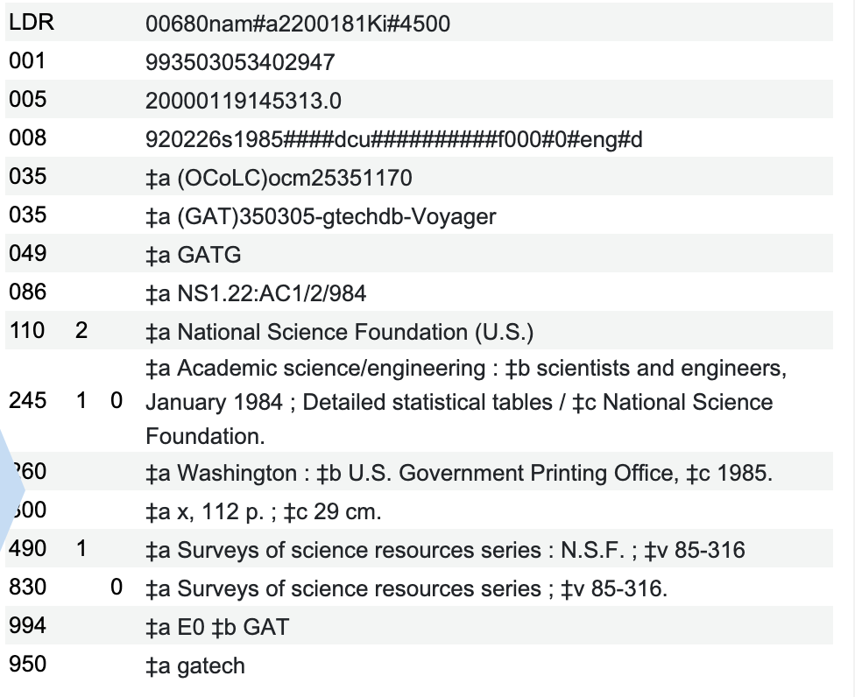


Pre-cleanup
Notes:
Bib rank of 75 or better is considered “good”

Slide 17
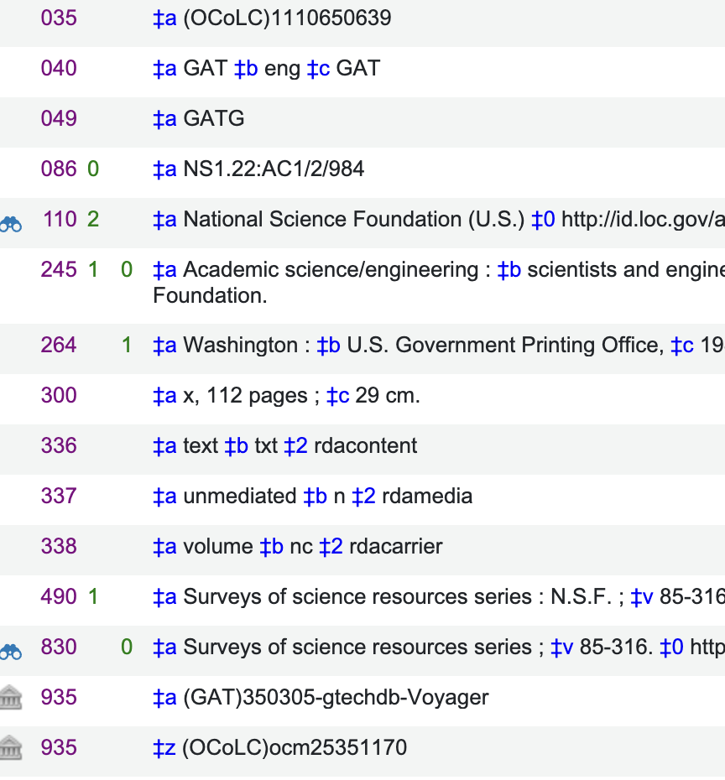
Post cleanup

Slide 18
My Cleanup Approach
Move Voyager IDs to 935$a using normalization rule
Move less-than-ideally formed OCLC# to 935$z
Rule 1: https://github.com/martinpatrick/eluna2024/blob/main/move%20old%20035%20to%20935.txt
Rule 2: https://github.com/martinpatrick/eluna2024/blob/main/process%20old%20voyager%20ids%20and%20move.txt

Slide 19
Examples
rule "move voyager id in same field as ocn step 2"
#combines other subfield z into one subfield and splits it
priority 8
when
(TRUE)
then
changeSubField "935.a" to "x"
changeSubField "935.z" to "x"
suffix "935.x" with ";"
suffixSubField "935.x" with "935.x"
removeSubField "935.z"
splitSubField "935.x.;" to "936.a"
removeField "935"
end
rule "move voyager id in same field as ocn step 3"
#for when voyager id already exists in its own 035 field
priority 7
when
(TRUE)
then
changeSubField "936.a" to "z" if (exists "936.a.*Voyager*")
copyField "936.z" to "935.a"
removeField "936" if (exists "936.z.*")
replaceContents "935.a.Z" with ""
addSubField "935.9.local" if (not exists "935.9.local")
end

Slide 20
Alma Automations

Slide 21
The Holdings Calculation
Theory: use a norm process to add a temp field based on holdings record characteristics that will ‘calculate’ the lending policy and will change the 008 bits
Rule 1:
Add TMP field = JRN based on 853/863/866
Add different TMP = MONLEN if there’s only an 852
Then, if neither field is present, add TMP = MONNO
For example:
rule "journal tmp"
priority 25
when
exists "866" AND exists "852.b.GTLSC" AND exists "852.c.GENERAL"
then
addField "TMP.a.JRN"
End
See: https://github.com/martinpatrick/eluna2024

Slide 22
The Holdings Calculation
Rule 2:
Use the data in the TMP field to decide what the lend/reproduce policy is
Update the 008 bits
For example:
rule "008 for journals"
when
exists "TMP.a.JRN"
then
replaceControlContents "008.{20,1}" with "b"
replaceControlContents "008.{21,1}" with "a"
end
See: https://github.com/martinpatrick/eluna2024

Slide 23
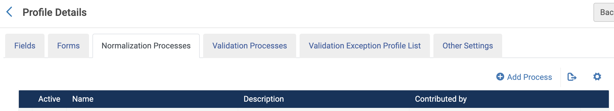
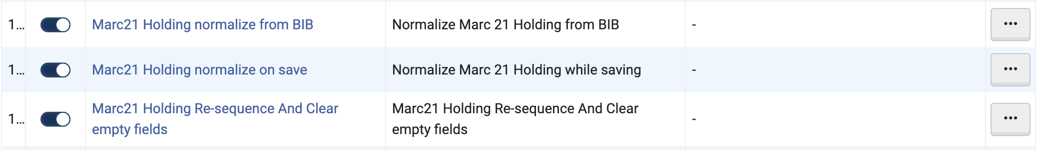
How to update Normalize on Save Rule
Add Norm Rule to normalize on save routines
Configuration -> Resources -> Metadata Configuration -> MARC21 Bibliographic -> Normalization Process OR MARC21 Holding -> Normalization Process

Slide 24
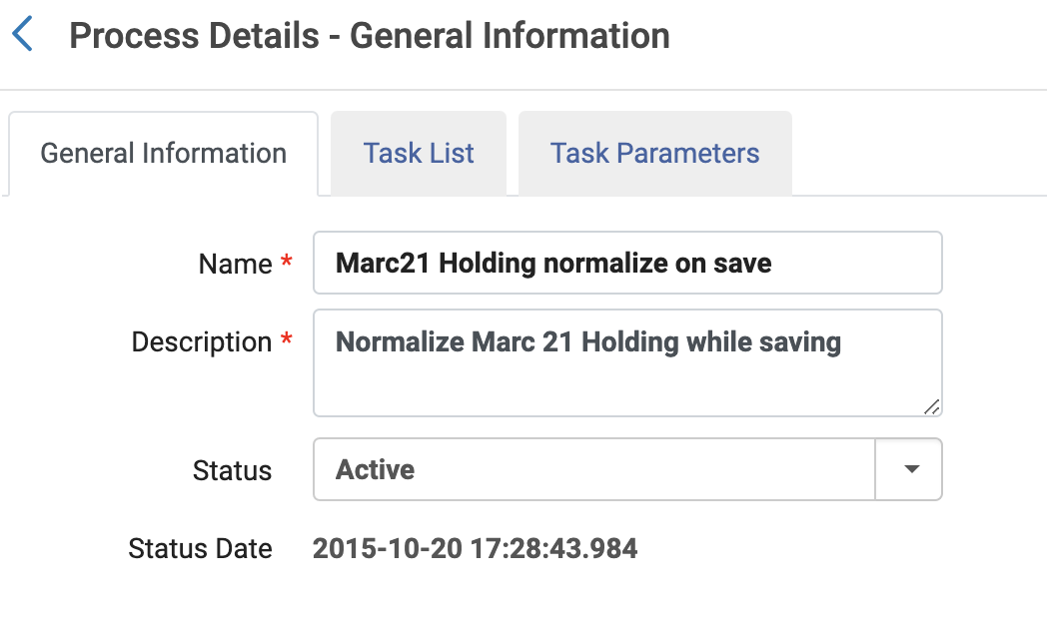
Adding Process

Slide 25
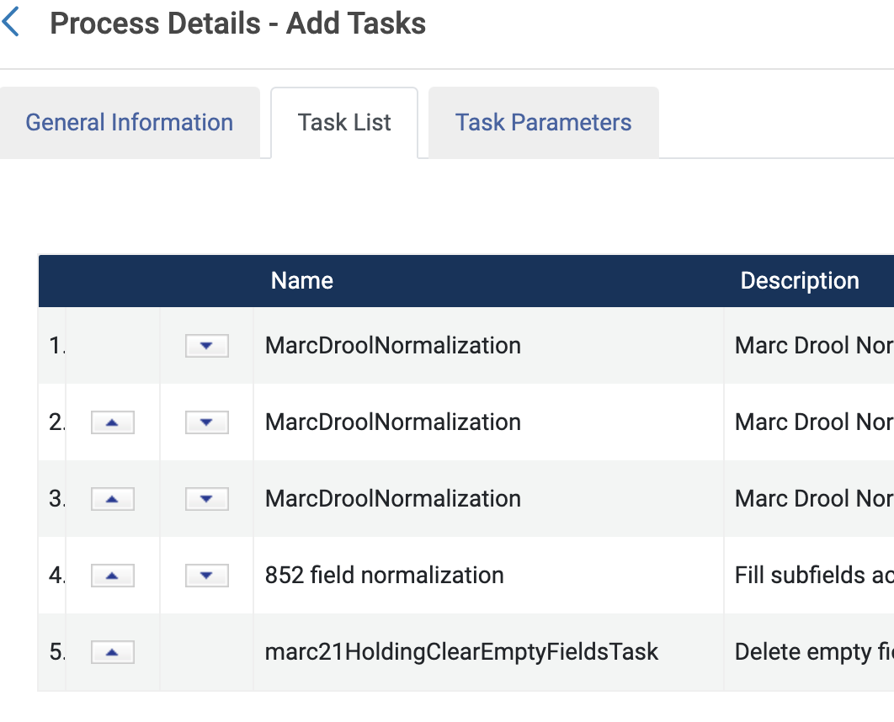
Adding Process

Slide 26
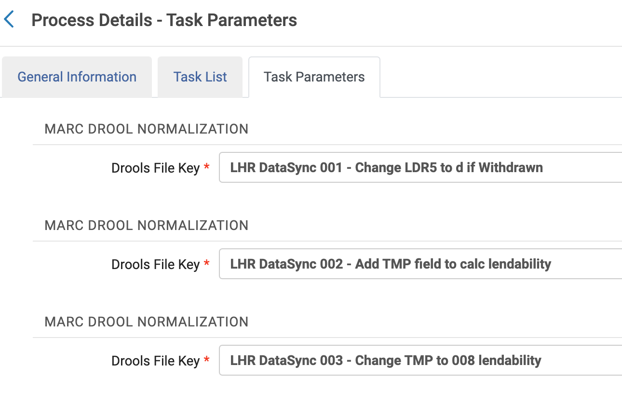
Adding Process

Slide 27
Combining the Calculation with Normalize On Save
The norm rules run automatically.
If we change our policies in the future, we can tweak the normalization rules for that.
If we change our locations in the future, we can tweak the norm rules for that.

Slide 28
Handling Withdrawals (still in process)

Slide 29
Normally…
The LHR rule would detect when we withdraw (aka delete) the final copy.
However, recall that we move things to a fake location rather than deleting.

Slide 30
Solution
Analytics: Everything in Withdrawn
Analytics: Fully Withdrawn with date filter
AND NOT
Analytics: MMS IDs that have other holdings
Analytics FTP Object
OCLC FTP
OCLC Non-MARC Delete DataSync Profile

Slide 31
Outcome

Slide 32
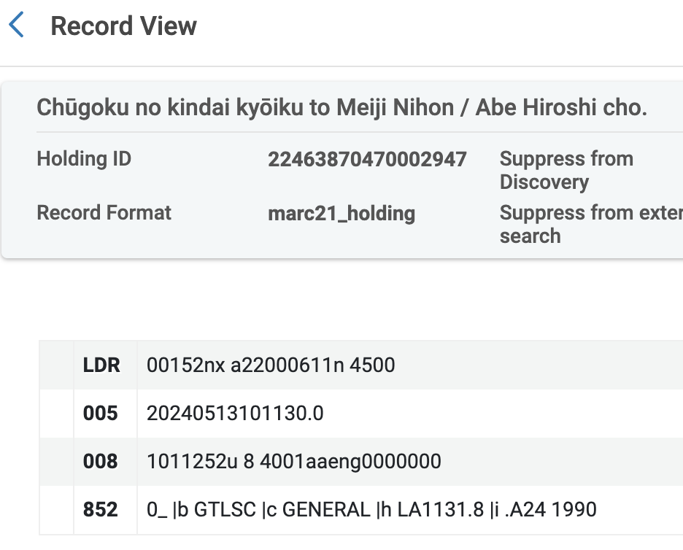
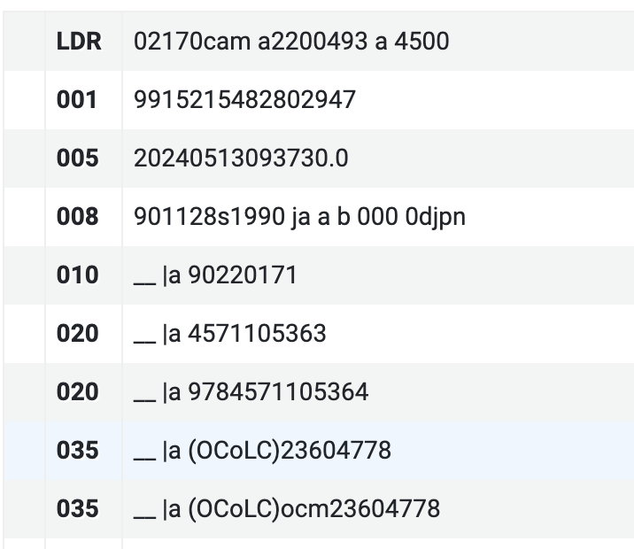

Slide 33
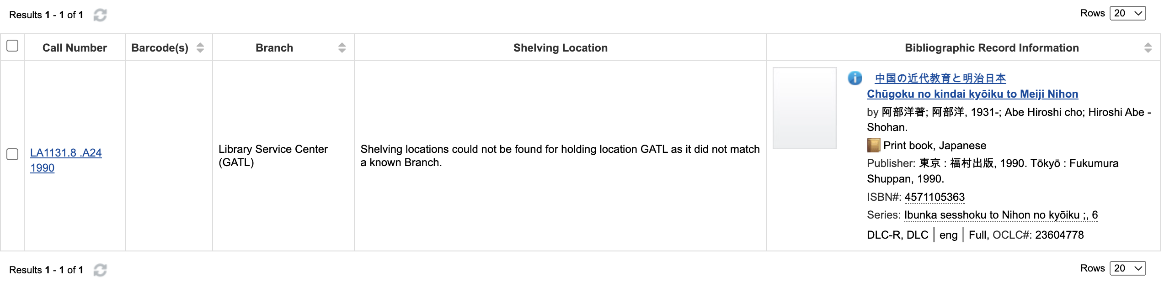

Slide 34
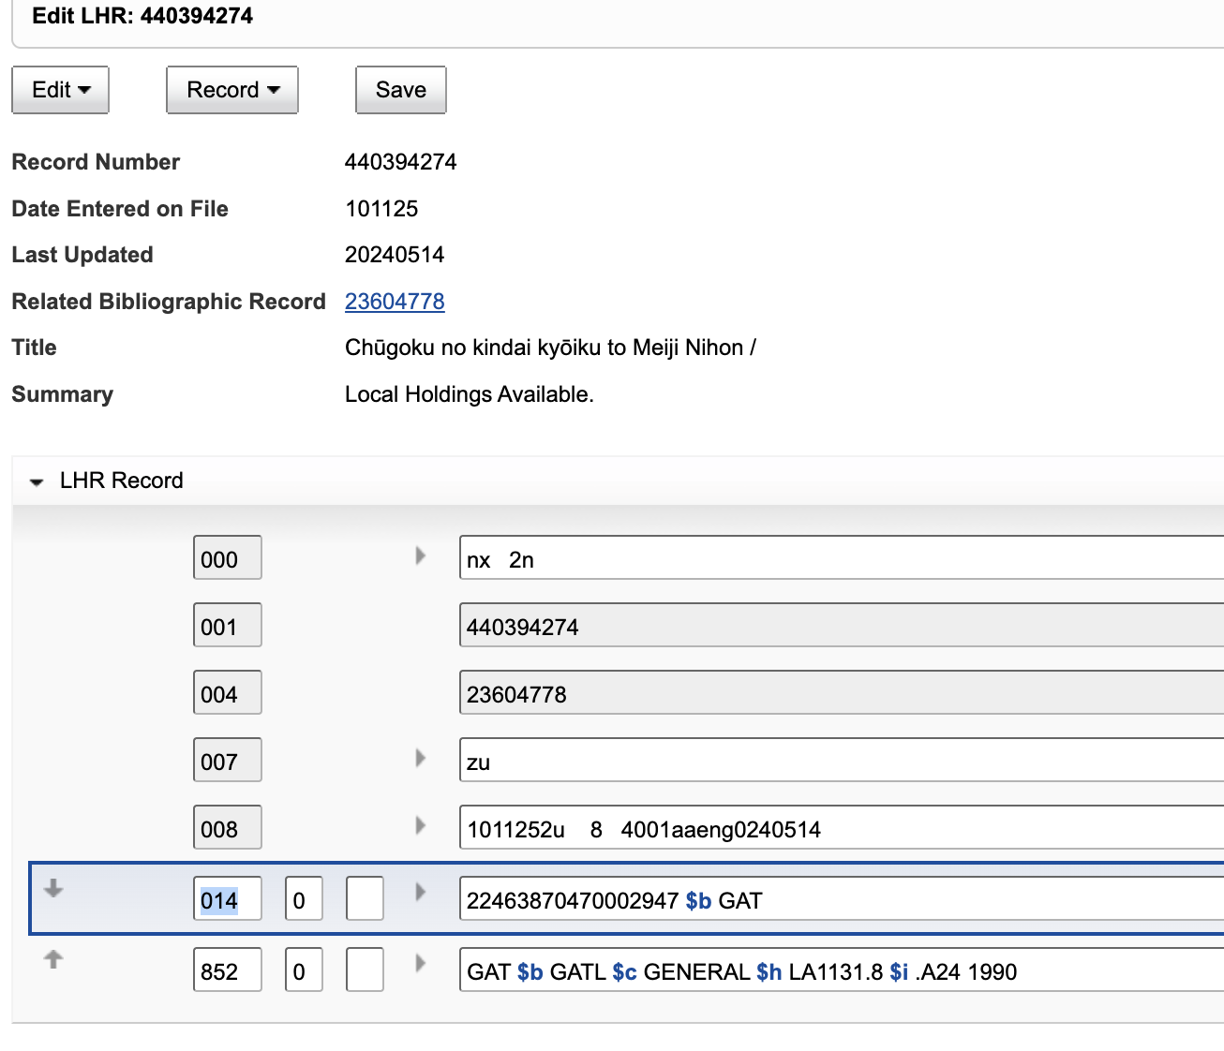

Slide 35
Questions?
ELUNA 2024
Martin Patrick: martin.patrick@library.gatech.edu
Deets on the git: https://github.com/martinpatrick/eluna2024

